Slide 1
MINECOFIN Quarterly Macro-Fiscal Model (QMFM)
Quarterly Macro-Fiscal Outlook (QMFO)
Summary Outlook Presentation 2023-26
Nov/Dec 2023 Round

Slide 2
Outline/contents
Rationale of outlook & underlying model
Recent macroeconomic developments
Macroeconomic forecast assumptions
Summary current cyclical position & policy stance & external environment
External environment assumptions
Domestic environment assumptions
Macroeconomic forecast/outlook
Summary of macroeconomic forecast/outlook (2023Q3-2027Q4)
Output and cyclical position
Fiscal stance, deficit and components
Inflation-headline CPI and components
Monetary policy–interest rates and exchange rates
Data issues and requests & suggestions
Alternative scenarios
QMFM: main relationships and transmission mechanisms

Slide 3
I. Rationale of outlook & underlying model
provide forecast 16 quarters ahead for key macro variables (i.e., output, inflation, final demands) as influenced by fiscal, monetary, and exchange rate policies, incl. in response to shocks and new developments
emphasis on fiscal and financing/debt variables
simulate alternative policy scenarios, analyze policy implications, and make policy recommendations
provide input for the validated macro-fiscal projections underpinning the (medium-term) Budgets and IMF-supported programs, complementing the intMF and other macro projection tools
facilitate policy coordination between MINECOFIN and NBR; IMF mission preparation; and policy debate
use of tool Quarterly Macro Fiscal Model: New-Keynesian, ‘semi-structural’, ‘gap’ model:
emphasis on fiscal variables & deficit components (revenue, govt spending & structural, discretionary, cyclical components)
tracing key macro variables in deviation from trends, potential levels, or targets:
after shocks and policy responses have worked out, variables return to their trends (subject to persistence) which converge to their steady state levels
outside model: potential growth, neutral interest rate, equilibrium real exchange rate change, sustainable deficit, target inflation rate

Slide 4
I. Rationale of outlook & underlying model Key concepts in the gap model (glossary)
Output gap & final demand gaps (+/-): above/below potential or trend level
Real interest & real exchange rate gaps: RIR and RER above/below neutral or equilibrium levels
Fiscal deficit relevant for demand impact: deficit before grants, total expenditure -/- non/tax revenue
Debt anchor & sustainable deficit: debt/GDP target (with LT growth, inflation rates, etc.) drives sustainable debt-creating deficit
Fiscal stance expansionary/contractionary: deficit and govt demand for G&S in % of GDP above/below trend (“discretionary” deficit and “discretionary” govt demand for G&S in % of GDP above/below zero)
More/less restrictive monetary policies: (real) interest rates above/below neutral or trend levels
More/less restrictive exchange rate policies : real exchange rate below/above equilibrium or trend level
Role of expectations: agents today take into account expected macro variables and policies in periods ahead (e.g., expected inflation, exchange rate, final demand gaps,…)

Slide 5
1I. Recent macroeconomic developments (2015-2023Q2) Real GDP/Output
Output gap drivers
Covid years (2020-21)
consumption and investment accounted for most of the GDP drop and negative output gap
fall in imports and expansionary government demand helped mitigate the downpull on GDP;
Immediate post-Covid (2021-22)
consumption and investment contributed most to the recovery
supported by continued government demand, while exports remained sluggish
Ukraine-war (2022-23)
post-Covid recovery slowed down due to jumps in international oil and food prices, causing high inflation and drop in real consumption and other demand
fiscal consolidation started (though in part thwarted by floods) and lowered the expansionary effect of govt demand
Real GDP, (YoY %)
trend growth (2000-19) averaged 7.5%
in COVID year 2020, GDP dropped 3.4% and was 12% below potential (had trend growth continued) due to drops in external and domestic demand and supply constraints
expansionary fiscal policy mitigated Covid output drop and helped subsequent recovery
global instability, esp. Ukraine-war, slowed down the recovery from 2022Q1 onward
despite strong bounce back in 2021, GDP estimated 6% below potential in late 2023

Slide 6
Fiscal policies and deficit components
Fiscal deficit (before grants, % GDP, GFS-1986) and Govt demand (%GDP)
some fiscal consolidation pre-Covid—slightly lowered deficits averaging 10% of GDP in FY2015/16—2018/19, mainly through lower spending on G&S (“discretionary”)
expansionary fiscal stance under Covid—increased deficits averaging 14% of GDP in FY2019/20—2021/22, mainly Covid-related spending on G&S (incl. school construction) and transfers/subsidies, mostly “discretionary” spending and deficit, only small “cyclical” deficit
start of fiscal consolidation post-Covid—deficit declined to 12% of GDP in FY2022/23, with spending on G&S falling by 3% points of GDP (despite flood-related spending)
fiscal stance entailed sharp drop in real govt demand for G&S, further exacerbated by surging inflation from early 2022

Slide 7
Inflation—headline CPI
Headline CPI—drivers (left chart)
Covid years (2020-21)
above target during 2020 induced by higher COVID-related food and core prices (imports)
Immediate post-Covid (2021-22)
lower, driven by still sluggish economy, good agricultural harvests, and less expensive imports
Ukraine-war (2022-23)
sharply increasing food prices: driven by negative agricultural production gap and other supply shocks
sharply increasing world energy and commodity prices
higher core prices: expectations, import prices (in/direct), supply-side shocks (pricing behavior not captured in model)
CPI , YoY %
highly volatile, mostly driven by factors unrelated to business cycle (e.g., agriculture & weather shocks, energy), output gap has only modest influence
food & energy prices contribute most to volatility, directly and indirectly
each inflation component has its own drivers (charts)
recent surge in inflation: weak harvests, soaring world food and energy prices, other domestic supply-side shocks….
deceleration observed in core and food inflation, fall in energy from 2023Q1

Slide 8
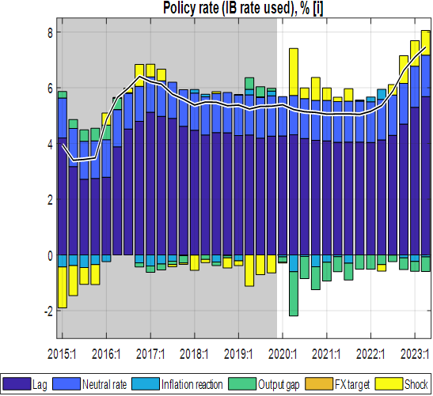
Monetary policies: IB and lending interest rates, nominal and real
Real interest rates, %
rose during Covid 2020-21, when inflation was subdued and the IB was lowered only once, by 0.5% 2020, in response to the Covid downturn
since mid-2021, below trends; IB even negative in most of 2022
from mid-2022, went back up sharply as nominal interest rates were moved up and inflation declined
real lending rates followed IB, and after a low point of 7% in mid-2022 reached some 12% by 2023Q3
IB (effective ‘policy’ rate)
since 2017 and esp. through 2020-21, IB was on a downward path and below its trend (‘neutral’) level of around 7%
since early 2022 to 2023, CBR raised stepwise from 4.5% to 7.5% in response to inflation—IB rate followed
IB rate almost back to neutral rate by mid-2023
.

Slide 9
Exchange rates: nominal and real
real exchange rate (RER), QoQ %
from mid-2020, the faster nominal depreciation (+) and subdued inflation more than reversed the earlier RER appreciation (-)
however, from late 2021 till 2022Q3, modest nominal depreciation and surge in core inflation lowered RER, to well below trend, more than offsetting the earlier increase
acceleration of nominal depreciation since late 2022 resulted in a sharp increase in the rate of RER depreciation
nominal Exchange Rate (ER), QoQ %
since late 2022, the ER depreciation rate has moved up sharply in line with the target ER depreciation rate
driven largely by high domestic inflation relative to trading partners, in addition to other factors (interest-rate differentials, trend RER depreciation rate, …)

Slide 10
III. Macroeconomic Forecast Assumptions Summary current cyclical position & policy stance & external environment
GDP/Output, YoY %
estimated slower growth of 6% in 2023 (due to Ukraine war shocks, inflation surge, weak agricultural performance)
estimated output gap (below estimated potential output) of -6% of GDP by mid-2023
Inflation—headline CPI QoQ %
expected to end at just above 10% in 2023—downward path from its peak of 25.6% in 2022Q2 driven by:
easing food price increases, falling energy prices
fading core-price shocks and tighter macroeconomic policies
Fiscal policy stance—deficit excl. grants and govt demand %GDP
fiscal consolidation of 2022/23 reinforced with next two Budgets: deficit reductions of 1% of GDP in 2023/24 and further 1% of GDP in 2024/25
shift in fiscal stance from expansionary (2019/20−2021/22) to contractionary (2022/23-2024/25), mostly borne by lower govt demand for G&S
switch average fiscal deficit: from 2% of GDP above trend to 2% of GDP below trend, with average total effect on output of +/-1.7% of GDP
Monetary—interest & exchange rate policy stance QoQ %
modestly tight monetary (policy amidst decelerating domestic inflation)—almost back to the neutral interest rate
real interest rate (RIR-IB) almost positive—still below its trend of 3%—helped to stem private demand in 2023 (though consumption and investment responded little to changes)
2023 acceleration of nominal ER depreciation largely offset Rwanda’s recent high inflation differential, reversing the overvaluation since late 2021
this has raised real exchange rate back to its trend by 2023Q3—positively affecting net exports
External environment (WEO projected)
overall, more favourable external environment thanks to recovering foreign demand, easing world food and oil prices & trading partner CPIs

Slide 11
External environment assumptions
overall outlook is improving after the Covid-Ukraine crises, but with downside risks.
World economy slowing down as interest rates are raised in response to inflation
Rwanda still enjoys recovery in trading partner demand relative to Covid-years, at 3% p.y., well above trend
World real interest rates are expected to rise from negative around -1% in the past decade to +1% by 2027,
increase likely transmitting one-for-one to Rwanda’s sovereign borrowing rates
trading partners’ CPI inflation (in US$)—subdued at 1.5% p.y. in the past 5-7 years
projected to return to its trend level of 2% in the coming years

Slide 12
Domestic environment assumptions
Nov. 2023 forecast round: “tuning” near-term policies, nowcasts and some shocks
fiscal consolidation: deficits before grants ‘set’ at PCI targets of 10.8% of GDP for 2023/24 and 9.7 % of GDP for 2025/26
beyond PCI, deficits (before grants) driven by fiscal anchor determined by target debt/GDP ratios, that is sustainable level of 8% of GDP
policy interest rate (IB): maintained at 8% for 2023Q4; thereafter: follows policy interest rate (IB) rule
exchange rate: tune current-year PCI-program targeted annual depreciation
e.g. path in 2023: first set at 7% y-o-y in Nov 2022, increased to 15% y-on-y in April 2023
GDP next two quarters: tuned with “now/forecasting”
agriculture: expected return to normal and fading of domestic food price shocks
core CPI: current quarter tuned, using preliminary price info
note: 2023/24 and 2024/25 Budget deficits and spending on G&S have been tuned based on the semester breakdown of annual figures (because the projected quarterly breakdown is not available), hence quarters are the same within the semester
Notes:
The QMFM sustainable debt-creating deficit is 5% of GDP under assumptions of: debt/GDP target of 55% (45% in NPV terms, o/w 10% domestic and 35% foreign debt, grant element 22%), real GDP growth 7.5% p.y., trading partner inflation 2% p.y., and trend RER depreciation rate 0%. The structural deficit consists of revenue 21%, government consumption 13%,government investment 11%, and other spending 5% of GDP.

Slide 13
IV. Macroeconomic forecast/outlook Summary of macroeconomic forecast/outlook (2023Q3-2027Q4)
Overall: modestly tight fiscal and monetary policies and still low RER contain demand and help lower inflation
headline CPI to continue declining, near 5% target by end-2024
GDP slowdown induced by recent inflation and policy response to continue for a few quarters
from mid-2024, GDP growth to pick up above trend till late 2026, helped by temporarily lower interest rates, high RER and a bit less restrictive fiscal from 2025/26; return to trend from 2027
fiscal policies 2023/24-2024/25 (PCI)
fiscal consolidation—negative discretionary spending (below-trend govt demand) and negative effect on private demand
expected negative effect on output (GDP) by some 1.7%
fiscal policies from 2025/26 onward
return to sustainable deficit—somewhat higher deficits than in 2023/34-2025/26, with gradually less negative discretionary govt demand and less negative impact on private demand
expected small positively effect on output (GDP)

Slide 14
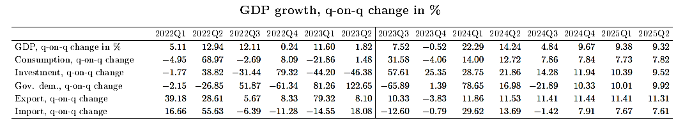
Forecast—Output and cyclical position (GDP growth)
growth of final demand components of GDP (Table LHS)
--relatively sharp fluctuations post-Covid period, esp. in investment,
--by late 2025 all final demands converge to their steady state levels
2022-23 sluggish GDP growth, driven by
--consumption recovery from Covid interrupted by Ukraine-war, inflation surge and restrictive policy response
--post-Covid fiscal consolidation with negative fiscal effect & impulse
2024-26 growth above trend, driven by
--remaining output gap
--less restrictive fiscal policies as deficit gradually back to (a bit higher) sustainable level and govt demand for G&S back to normal
--exports helped by high RER
from 2027, back to trend growth of 7.5%
--no indication that Covid has permanently reduced potential output and its growth

Slide 15
Forecast—cyclical total demand driving GDP
--output gap closing in as output (level) approaching its trend by 2026
--output gap moves around zero trend when its level catches trend
Output-below-potential (negative gap) declines gradually
--lessening down pull from consumption which goes back to normal
--large initial down pull from reduction in real government spending, but gradually disappearing from mid-2024
--exports helped by increased RER

Slide 16
Private consumption and cyclical position
Consumption back to trend, drivers
--persistence, lagged effect
--expectations
--income, proxied by real GDP
--negative fiscal impulse
Consumption gap
--estimated to recover from recent low levels but remains restrained in 2024
(by low GDP growth and contractionary fiscal stance in 2023-24)
--returns to trend growth in late 2026 when fiscal and monetary policy become somewhat less restrictive.
Notes:
We tuned GDP down in 2023Q1 (nowcast), and tuned cons down too (shock)

Slide 17
Private investment, exports & imports and cyclical position
Private investment returns to trend
main drivers:
--persistence (lag) and expectations
--small effect of real interest rate (RIR)
--no RER effect (zero weight in Monetary Conditions Index)
--small income effect (proxied by real GDP)
--small effect of fiscal impulse
Exports return to trend
main drivers:
--persistence (lag)
--expectations
--foreign demand (mainly relevant for tourism, albeit with small coefficient)
--earlier down pull from RER overvaluation disappears
Import demand returns to trend
main drivers:
--final demand components, esp. consumption, govt demand, investment
--RER effect reverses to negative as real depreciation (lower overvaluation) reduces imports
Notes:
We tuned GDP down in 2023Q1 (nowcast), and tuned cons down too (shock)

Slide 18
Fiscal stance (i): govt demand for G&S affects output directly
Fiscal policies affecting output in short-run via several channels captured in the model:
--from 2023Q2, govt demand % GDP switches from above to below its structural trend
--implies negative govt demand in 2023-25, fading thereafter
Government demand for G&S (direct) (+ 23% of GDP):
--deficit reduction in fiscal program FY2023/24 and 2024/25 mostly from ending has Covid and post-Covid crisis-related spending on G&S and investment cuts
--discretionary govt demand turning from above trend (expansionary) to below trend (contractionary)
--significant negative effect on demand, forecast to last till early 2026
Notes:
See Output gap and Fiscal Impulse in last Chart

Slide 19
(ii): fiscal impulse affects output via private demand
(i+ii) fiscal stance: total output effect via Govt and private demand
“fiscal impulse”—mainly discretionary deficit—affects private demand and hence output indirectly
--turns negative from late 2022 for several years
--works on private demand via transfers/subsidies and revenue and ‘optimism effect’ of fiscal stance
fiscal stance direct and indirect effect on output
--average negative discretionary deficit of 2% of GDP during 2023-25
--estimated to lower real GDP by some 1.7%, mainly from lower govt demand for G&S (two-thirds) and the remainder from lower private demand
Notes:
In more aggregate models, “fiscal impulse” comprises both direct effect of govt spending on G&S and the indirect effect via private consumption and investment (affected by transfers/subsidies and reduced effective revenue collection)

Slide 20
Fiscal stance: deficit and its components (revenue, spending) and model decompositions (structural, cyclical, discretionary)
Budget deficit (excl. grants), %GDP (revenue, demand G&S, other exp.)
--2023/24-2024/25 deficits tuned at 10.8% and 9.7% of GDP (~PCI program)
--implies negative discretionary deficit (below trend or sustainable level)
--beyond PCI-program (from 2025/26), deficits return to sustainable levels
(from debt/GDP anchor, i.e., 8% of GDP o/w: 5% debt-creating deficit)
--constituent parts (revenue, demand, oexp) gradually toward structural levels
Budget deficit (excl. grants), %GDP (structural, cyclical, discretionary)
--structural deficit at sustainable level of 8% of GDP
--fiscal consolidation 2023/24-2024/25 means negative discretionary deficit
--mainly via negative discretionary govt demand for G&S (in part ‘offset’ by below-trend revenue)
Notes:
Optional illustration of fiscal impulse in relation to output/gap

Slide 21
Forecast—Inflation outlook
Headline CPI (YoY %)
--forecast to continue declining but with a modest flare-up in 2023Q4
--and decline below 5% from 2024Q4
--largest contribution from moderation in food and energy price increases (even fall in food prices)
Core CPI (QoQ %)
--gradual drop, driven by expectations, small upward direct effects of import prices and RER
--falls in mid-2025 slightly below its target of 4.5% (down-pull from remaining negative output gap)
Food CPI (QoQ %)
--fast drop, mainly driven by fading negative agricultural output gaps
--upward direct effect of imported food prices (due to ER depreciation),
--earlier shocks (supply-side factors), already small in late 2023 are forecast to disappear from 2024
Energy CPI (QoQ %)
--rapid drop, mainly driven by direct effect of imported energy prices (projected to fall throughout 2023-27)
--exchange rate depreciation exerts some upward pressure
--shocks (incl. due to pump price changes) to disappear from 2024

Slide 22
Forecast—Inflation outlook
headline CPI (YoY%)
--forecast to continue declining but with a modest flare-up in 2023Q4
--and decline to below 5% from 2024Q4
--largest contribution from moderation in food and energy price increases (even fall in food prices)
core CPI (QoQ%)
--gradual drop, driven by expectations, small upward direct effects of import prices and RER
--falls in mid-2025 slightly below its target of 4.5% (down-pull from remaining negative output gap)
food CPI (QoQ%)
--fast drop, mainly driven by fading negative agricultural output gaps
--upward direct effect of imported food prices (due to ER depreciation),
--earlier shocks (supply-side factors), already small in late 2023 are forecast to disappear from 2024
energy CPI (QoQ%)
--rapid drop, mainly driven by direct effect of imported energy prices (projected to fall throughout 2023-27)
--exchange rate depreciation exerts some upward pressure
--shocks (incl. due to pump price changes) to disappear from 2024

Slide 23
Forecast—interest rates (interbank rate (IB) and lending rate)
IB rate, %
--tuned for Q4 2023, assuming NBR would keep its CBR unchanged from August 2023
--about 0.5% points above the CBR
--IB trend/neutral level (+ 7.5%) (trend foreign RIR 1%), country risk premium (2%), and core inflation target (4.5%)
drivers of policy rule in 2024
--expected inflation deviation from target (-)
--negative output gap (-)
--pull from neutral rate (7.5%) (+)
--gradual changes (lagged effect)
IB rate, %
--gradually lowered from peak of + 8% in August 2023 to + 6.5% in late 2024
(inflation drops, - output gap remains)
--from mid-2025, toward neutral level
RIR−IB rate, %
--after significant drop, even negative (early 2021−mid-2023),
--forecast to continue rising until mid-2025 as inflation eases
--then remain near its trend level of 2.5-3%
--slightly drop below trend in late 2025, as inflation slightly up as govt demand returns to trend
real lending rate, %
--4Q forward average RIR(IB) + lending premium (+ 9% points above IB)
--RIR (as steered by CBR) transmitted to real lending rate
--after below-trend during and after Covid (as inflation surged 2022-23),
--to go back near trend from 2024

Slide 24
Forecast—Nominal and Real Exchange Rate (ER & RER)
nominal ER, QoQ%
--forecast reflects NBR’s flexible exchange rate policy and hybrid rule in practice (steering ER to target ER so RER gradually matches target depreciation rate, in turn driven by inflation differentials and trend RER change (0%) )
--after faster-than-target depreciation in 2023 (av. annualized 15%),
returns gradually to target ER depreciation rate
--contributing to reversal of recent overvaluation due to surge in inflation
RER, QoQ%
--slowdown in pace of RER depreciation (from peak in 2023) to return gradually to its trend (0%)
--fast reversal of sharp RER decline during 2021-22—with perhaps some overshooting—is forecast to increase net exports and demand
--return to trend RER change implies current positive RER gap disappears by 2027 and positive effect on net imports ends

Slide 25
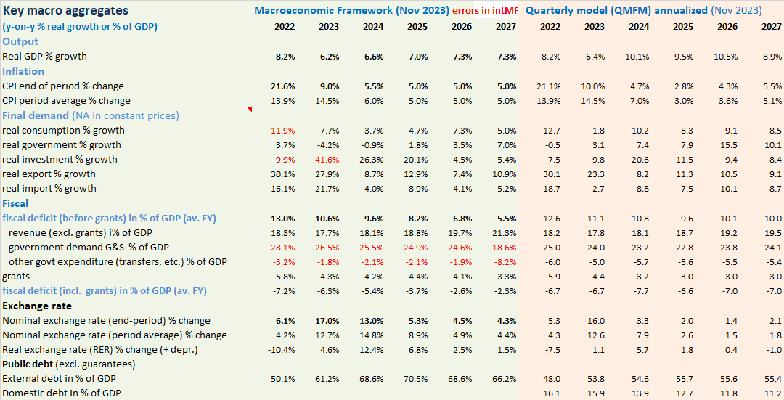
V. Comparison with Integrated Macro Framework (intMF)
comparison with latest intMF projection (PCI)
process of reconciling results from different tools, in iterative manner (at least for each PCI review)
QMFM better traces final demands and output in ST, smooth behavioral functions
intMF has private investment exogenous, consumption residual, can lead to implausible projection, volatility
illustrative current comparison
QMFM CPI inflation more accurate as it traces inflation by quarter
QMFM: higher post-PCI fiscal deficits (in line w debt/GFDP targets)
QMFM: much lower post-2023 ER depreciation than intMF
(which assumes large pre-Covid RER overvaluation needs to be corrected)
some differences due to measurement of govt demand in NA vs Budget and anomalies in inventories in NA, NA deflators, …… (to be resolved by NISR)

Slide 26
VI. Data issues and requests & suggestions
Model/Outlook data issues to be addressed
intMF – fiscal (govt demand for G&S, quality Q data, timely Q treasury plan), GDP/final demand deflators
debt data & projections (timely & complete incl. Q data and projections integrated into intMF)
NA/NISR – discrepancies/anomalies Govt consumption, investment, inventories, final demand deflators
NBR – timely monetary survey and interest rates,
NBR-FPAS results, analysis of potential output, international interest rates (GPM)
WEOGAS & GEE in right format– timely sharing by IMF staff, QoQ projection instead of YoY
timely data reconciliation and iterative comparison of forecast results of various tools, as input for intMF, well before each Review and each quarter
Notes:
MINECOFIN can have a different assessment of path and impact of monetary and ER policies than NBR, just as NBR can have a different assessment of path and impact of fiscal policies.

Slide 27
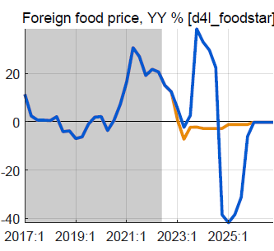
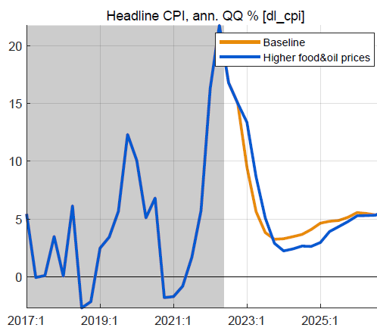
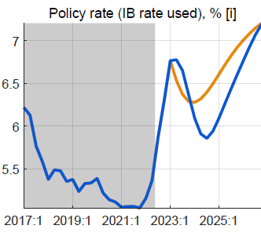
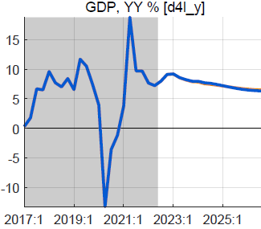
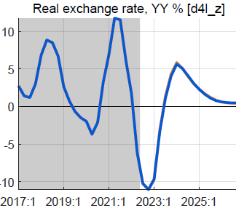
VII. Alternative scenario: higher foreign food/oil prices (2023-24)
Higher-than-WEO foreign food and oil prices in 2023-24
foreign food and oil prices on average 25% higher than BL
with peak around end-2023, return to WEO levels from 2025
no change in fiscal policy
Results in higher headline CPI, little or no effect on output
headline CPI temporarily higher, reflecting food/oil import shares
small response policy rate, reversed fast as expected inflation drops
small positive effect on demand of lower RIR
mostly offset by negative effect of slightly more appreciated RER
overall effect on GDP is very small, less than 0.2%

Slide 28
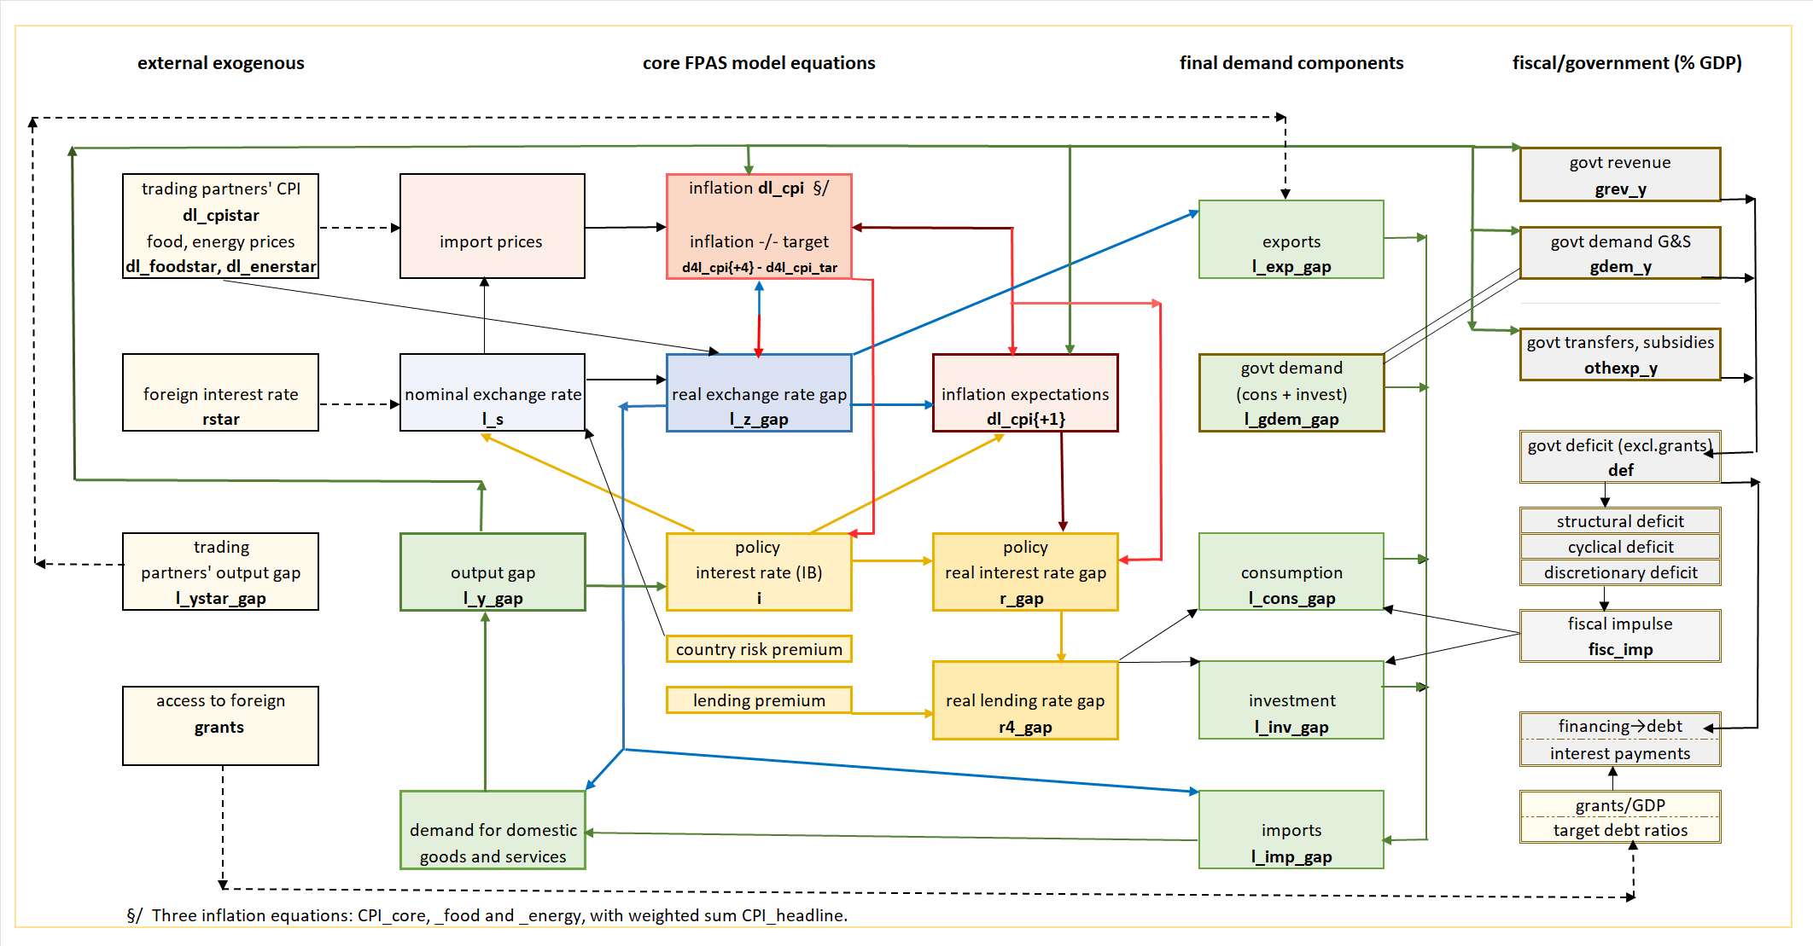
VIII. QMFM: main relationships and transmission mechanisms

Slide 29
THANK YOU

